Slide 1
Java design patterns
MPCS 51037 – Advanced java Programming

Slide 2
What are java design patterns & WHY Use them?
What?
Solutions to general problems faced in software development
Industry standard approach to solve recurring problems
Why?
Promotes reusability: more robust and maintainable code
Faster development, code easier to understand, debug
Provides standard terminology
Notes:
Not the specific solution, but they are descriptions/templates for how to best solve a problem
Common platform that can be applied to many different situations
Formalized best practices
Standard terminology

Slide 3
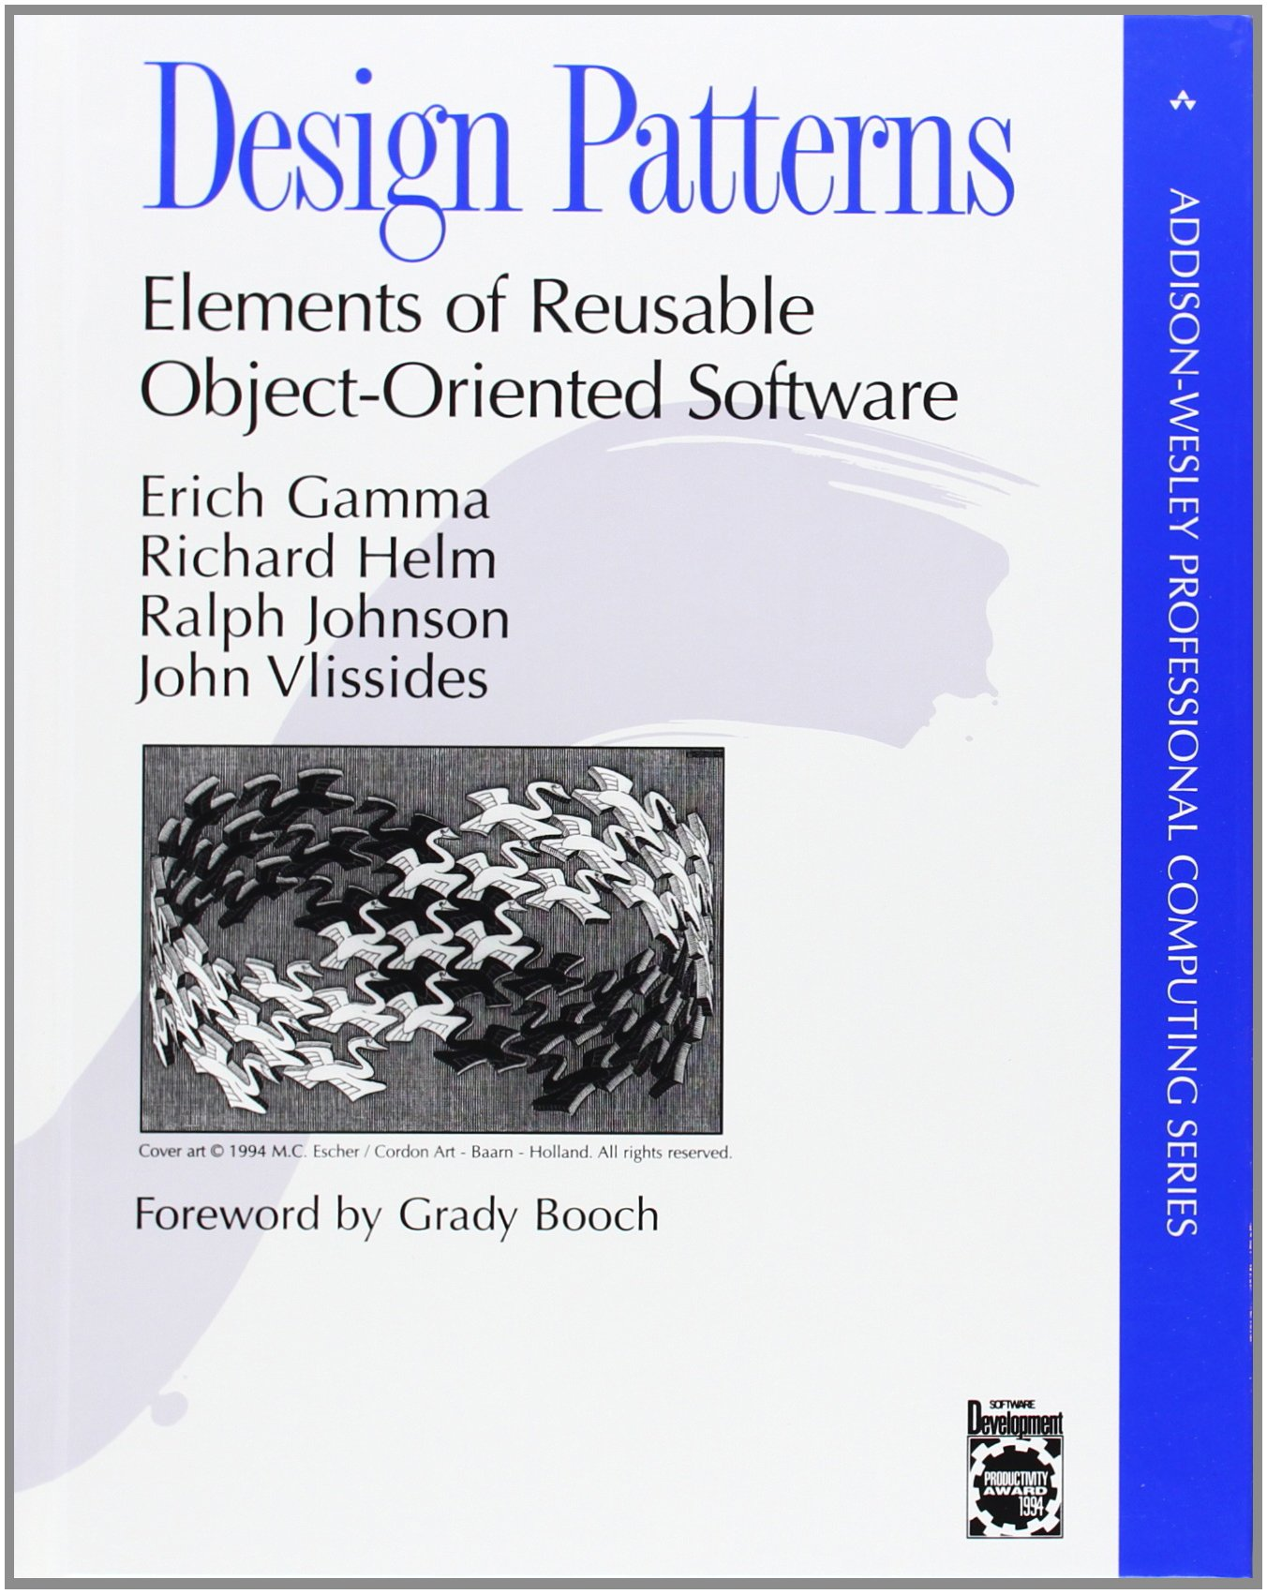
How they came to be
1994 – Gang of Four: Authors Erich Gamma, Richard Helm, Ralph Johnson, & John Vlissides
Book: Design Patterns – Elements of Reusable Object-Oriented Software
Design Patterns based on these principles of OO design:
Program to an interface, not an implementation
Favor object composition over inheritance
Notes:
Gang of 4 – authors, published this book which initiated the concept
Interface – client doesn’’t need to be aware of the specific types of objects for example, only need to know about interface/ abstract classes
Obj composition – containing instances of other classes that implement desired functionality – instead of inheritance from a parent class – more flexible, polymorphism is better implemented this way
The book first talks about the capabilities/pitfalls of OOP, and then the rest of the book talks about 23 different patterns
The book has examples in C++ and Smalltalk

Slide 4
3 main types of design patterns
Creational Patterns
Structural Patterns
Behavioral Patterns
Singleton
Factory
Abstract Factory
Builder
Prototype
Adapter
Composite
Decorator
Bridge
Façade
Flyweight Proxy
Chain of Responsibility
Command
Interpreter
Iterator
Mediator Memento
Observer
State
Strategy
Template
Visitor
Notes:
4th type: J2EE - presentation

Slide 5
Type: Creational Patterns
Way to create objects while hiding logic
Does not use the “new” operator
Offers more flexibility in deciding which objects need to be created for a given case
Solution to instantiate an object in the best possible way for the situation
Notes:
Allows for a more general and flexible approach in being able to create different objects
Decouples client from the objects it needs to instantiate

Slide 6
Type: Structural patterns
Provide different ways to create a class structure
Using inheritance to compose interfaces & define ways to create objects to get new functionality
E.g. using inheritance & composition to create a large object from small objects
Notes:
Simpler way to define relationships between classes in the structure

Slide 7
Type: Behavioral patterns
Concerned with communication & better interaction between objects
Provide loose coupling and flexibility to extend easily
Notes:
Loosely couple the implementation and the client to avoid hard coding / dependencies, so the objects can easily talk to each other

Slide 8
Creational: factory
Super class with multiple sub classes – return one of the sub-classes
Refer to newly created object using a common interface – no need to expose logic to client
One of the most widely used patterns – great way to create an object
Notes:
Allows for more long term flexibility, and again more decoupling

Slide 9
Creational: singleton
One of the simplest patterns
Creates an object making sure only one object gets created
Provides a way to access the only object without needing to instantiate the object of the class – private constructor and public accessor method
Notes:
Often control access to resources such as a database connection – have a license for only 1 connection for your database, Singleton makes sure only 1 connection is made

Slide 10
Singleton example: Command center (proImageshop)
public class Cc { private static Cc stateManager; private Stage mMainStage, mSaturationStage; private static ArrayList<Image> backImages;
private Cc(){ } /** * Create a static method to get instance. */ public static Cc getInstance(){ if(stateManager == null){ stateManager = new Cc(); backImages = new ArrayList<>(); } return stateManager; }
Notes:
getInstance() is the global access point for the outer world to get the instance of this singleton class, private constructor to restrict instantiation from other classes, private static variable

Slide 11
Creational: builder
Make and return one object various ways
Separates construction of an object from its representation
Allows for the same construction process to create different representations
Example: constructing a (typical) meal at a restaurant – always has a drink, side, entrée, dessert – but each individual item can vary (chicken vs fish)
Notes:
Similar to factory but key difference – factory is a more simplified version, user doesn’t need to know the subtype. Builder – different subtypes are created by a builder method – allows for finer granularity & detail. Factory requires the object to be built in a single line while Builder allows for setter methods to build up the parameter list – more complicated objects. Using factory can evolve toward using Builder

Slide 12
Structural: adapter
Allows interface of an existing class to be used as another interface
Helps two normally incompatible interfaces to work together
Converts interface into one expected by user
Notes:
Often used to make classes that exist work with other classes without changing source code

Slide 13
Structural: façade
Adds an interface to a system to hide complexities
Single class with simplified methods
Make the client application easier to understand
Notes:
Can wrap a more complicated subsystem with a simpler interface

Slide 14
Behavioral: command
Command, Receiver, Invoker, Client
Allows for encapsulation of actions within classes – perform action later – “ready to run”
Request is sent to invoker which passes it to the encapsulated object that can handle the command and passes it to the corresponding object that executes the command
Command interface classically has an execute() method
Notes:
Command objects knows about receiver and invokes a method of the receiver. Receiver does the work – an invoker object knows how to execute a command. Client passes the command object to the invoker object to execute the command
Invoker looks for the appropriate object

Slide 15
Behavioral: iterator
Used to traverse a container and access elements
A way to access elements without exposing underlying representation
Interface to traverse different collections

Slide 16
ReSources
http://fuzzduck.com/Design-Patterns/Iterator-Pattern.php
https://www.javacodegeeks.com/2015/09/java-design-patterns.html
https://sourcemaking.com/design_patterns
http://www.tutorialspoint.com/design_pattern/index.htm
http://www.javatpoint.com/design-patterns-in-java
http://www.oodesign.com/design-principles.html

